Slide 1
Capstone 1 Abdulraouf almughyirah

Slide 2
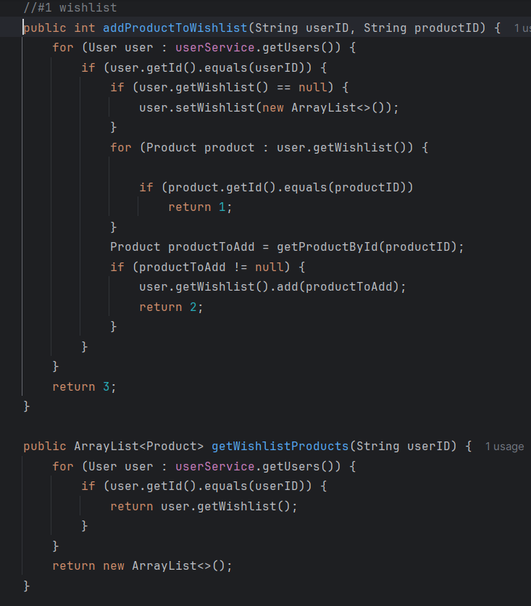
Endpoint 1

Slide 3
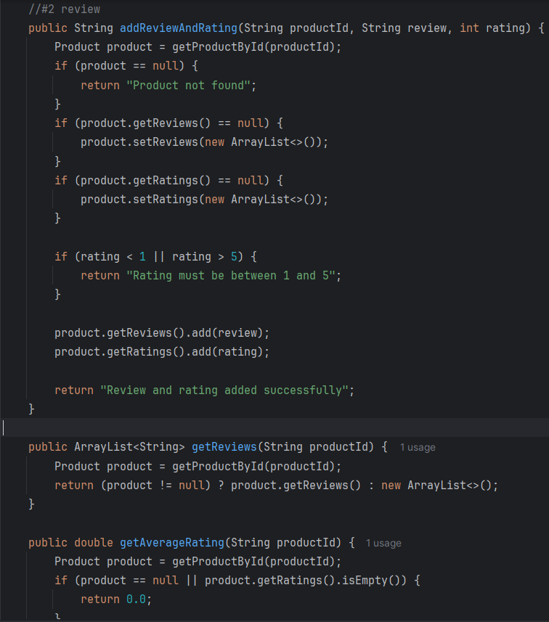
Endpoint 2

Slide 4
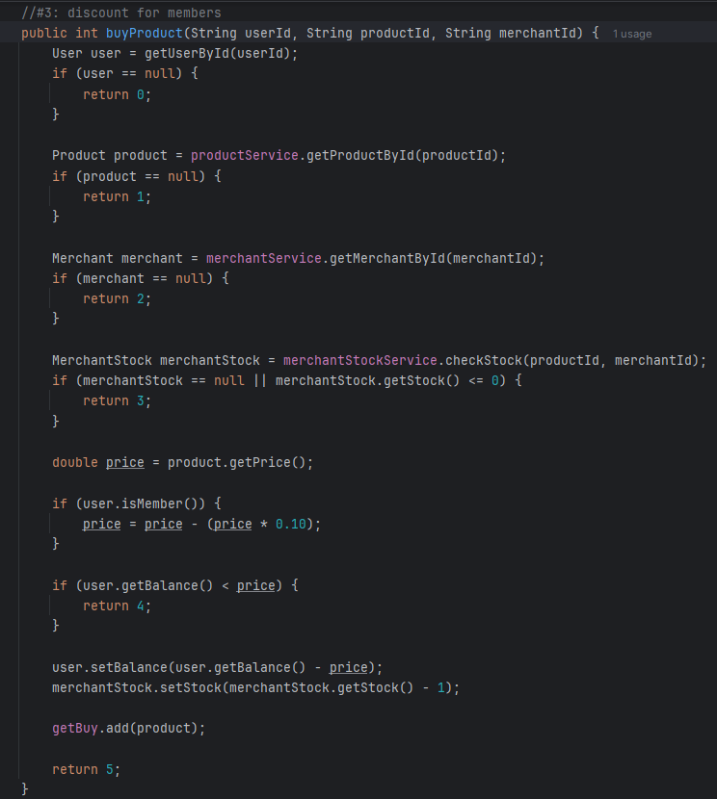
Endpoint 3

Slide 5
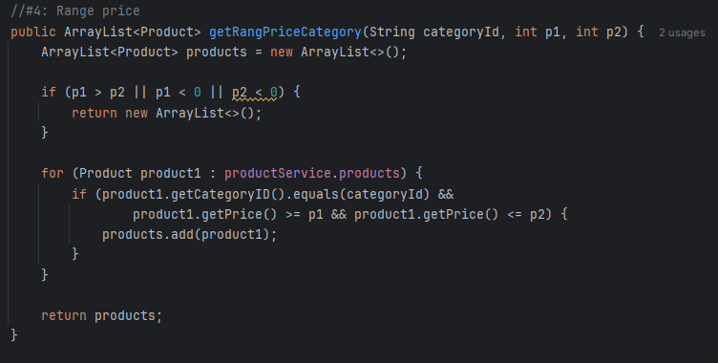
Endpoint 4

Slide 6
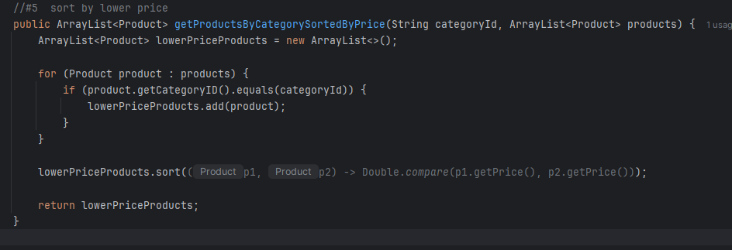
Endpoint 5

